Slide 1
Multitenancy in Embedded Analytics Solutions
Ted Pattison
Principal Program Manager
Power BI Customer Advisory Team (PBICAT)

Slide 2
More Material from Power BI Dev Camp
Power BI Dev Camp Portal - https://powerbidevcamp.net

Slide 3
Agenda
Developing with Service Principal Profiles
Designing Multi-tenant Applications using Service Principal Profiles
Designing Datasets with Row Level Security (RLS)
Using RLS with App-Owns-Data Embedding

Slide 4
Choosing Between User-Owns-Data and App-Owns-Data
User-Owns-Data Embedding (SaaS)
All users require a Power BI license
Useful in corporate environments
App authenticates as current user
Your code runs with user’s permissions
User’s AAD access token passed to browser
App-Owns-Data Embedding (PaaS)
No users require Power BI license
Useful for ISVs and commercial applications
App authenticates as service principal
Your code runs with workspace admin permissions
Embed token passed to browser
User-Owns-Data Embedding for use within Organization
App-Owns-Data Embedding for use by ISVs
Browser
Power BI Service
Browser
Power BI Service
iFrame
iFrame
Azure AD
Access Token
Power BI
Embed Token

Slide 5


Designing Multi-tenant Application with App-Owns-Data
Application is responsible for creating and managing customer tenants
Customer tenants created using Power BI workspaces
Application provides logic to configure and populate workspace
Power BI Multi-tenant Environment
Customer 01 Tenant
Azure SQL
Customer 1 DB
Customer 01
17 users
Power BI Workspace
Power BI Report
Power BI Dataset
Datasource credentials
Sales
Customer 02 Tenant
Azure SQL
Customer 2 DB
Customer 02
118 users
Power BI Workspace
Power BI Report
Power BI Dataset
Datasource credentials
Sales
Customer N Tenant
Azure SQL
Customer N DB
Customer N
233 users
Power BI Workspace
Power BI Report
Power BI Dataset
Datasource credentials
Sales

Slide 6
Writing Customer Tenant Provisioning Code
Sequence of Power BI REST API calls to create new customer tenant
Create new workspace
Associate workspace with premium capacity
Import PBIX to create dataset
Update dataset parameters
Set datasource credentials
Start dataset refresh operations
Best practice is to call Power BI REST API as service principal
Avoid problems with MFA and managing user password rotation

Slide 7
Understanding the 1000 Workspace Limitation
Service principal cannot be member of more than 1000 workspaces
Purpose of limitation is to maintain high levels of performance
Performance suffers as service principal is added to more workspaces
1000 workspace limitation is not enforced through code in Power BI Service
Observations about the 1000 workspace limitation
Scenario where service principal is member of 1000+ workspaces is unsupported
Performance slows as the number of workspace memberships for SP increases
Being member of 100 workspaces will perform better than 1000 workspaces
Being member of 10 workspaces will perform better than 100 workspaces
Optimal number of workspace memberships for performance reasons = 1

Slide 8
Understanding Dataset & Datasource Credentials Isolation
Multitenant design should isolate customer tenants from one another
You don't want users seeing data from another tenant belonging to a different customer
Each dataset is owned by a user or service principal
Dataset owner must set datasource credentials to connect to underlying datasource
Datasource credentials scoped by service principal and this scope extends across all workspaces
It's possible (but not recommended) to share dataset credentials across workspaces
Power BI Multi-tenant Environment
Customer 01 Tenant
Customer 01
17 users
Power BI Workspace
Power BI Report
Power BI Dataset
Azure SQL
Datasource Credentials
Sales
Customer 02 Tenant
Customer 02
118 users
Power BI Workspace
Power BI Report
Power BI Dataset

Slide 9
Design Strategies Before Service Principal Profiles
Multi-tenant application design solutions used in the past
Single Service Principal
Service Principal Pooling
One Service Principal per Customer Tenant

Slide 10


Solution 1 – Single Service Principal
Only supported until you reach 1000 workspaces
Less performant when service principal is member of 100s of workspaces
Service principal is owner of datasource credentials across all customer tenants
Requires one-time creation of Azure AD application for service principal
Multi-tenant Environment in the Power BI Service
Customer 1
Multi-tenant Application
Workspace for Customer 1 Tenant
Customer 2
Service
Principal
Workspace for Customer 2 Tenant
Customer 3
Workspace for Customer 3 Tenant
Customer N
Workspace for Customer N Tenant

Slide 11
Solution 2 – Service Principal Pooling
Can scale to any number of required tenants
Less performant when service principal is member of 100s of workspaces
Service principals are owner of datasource credentials across multiple customer tenants
Requires occasional need to create new Azure AD applications as # of tenants increases
Multi-tenant Environment Power BI Service
Customer 1
Multi-tenant Application
Workspace for Customer 1 Tenant
Service
Principal
Customer 2
Workspace for Customer 2 Tenant
Customer 3
Service
Principal
Workspace for Customer 3 Tenant
Customer N
Workspace for Customer N Tenant

Slide 12
Solution 3 – One Service Principal per Customer Tenant
Can scale to maximum number of service principals allowed in Azure AD (50,000)
Best Performance because service principal is only member of a single workspace
No service principal owns datasource credentials for more than one customer tenant
Requires continual need to create new Azure AD applications for new tenants
Multi-tenant Environment Power BI Service
Customer 1
Multi-tenant Application
Workspace for Customer 1 Tenant
Service
Principal
Customer 2
Workspace for Customer 2 Tenant
Service
Principal
Customer 3
Workspace for Customer 3 Tenant
Service
Principal
Customer N
Service
Principal
Workspace for Customer N Tenant

Slide 13
Comparing Solutions Before Service Principal Profiles
Each solution has strengths and weaknesses compared to the others
 | Single Service Principal | Service Principal Pooling | Service Principal per Tenant
Azure AD Overhead | Low | Medium | High
Datasource isolation | None | Partial | Complete
Power BI API Performance | OK | OK | Optimized

Slide 14
Understanding Service Principal Profiles
Service principal profiles are created as local accounts in Power BI Service
New Profiles API allows service principal to create service principal profiles
No limit on how many service principal profiles can be created by a single service principal
Service principal profiles are unknowns to Azure AD – it's totally a power BI thing!
Parent-child relationship exists between service principal and the profiles it creates
Service principal profiles are never stand-alone – they're always associated with service principal
Service principal profile can only be seen and used by service principal which created it
Service principal profile not accessible from other service principals or users
Power BI Service
profile 1
Service
Principal
profile 2
profile 3

Slide 15
Service Principal Profiles and the Power BI Security Model
Service principal profile is first-class security principal in Power BI authorization system
Service principal profile can be added as workspace member
Service principal can execute Power BI REST API calls under identity of service principal profile
Service principal profile can create workspaces and datasets and set datasource credentials
Service principal profile can generate embed token for App-Owns-Data embedding
Multi-tenant Application
Workspace for Customer 1 Tenant
profile 1
Service
Principal
Workspace for Customer 2 Tenant
profile 2
profile 3
Workspace for Customer 3 Tenant

Slide 16
Service Principal Profile Per Customer Tenant
Can scale to any number of required tenants (e.g. 100,000+)
Each service principal profile owns datasource credentials for one customer tenant
Optimized performance due to profile being member of single workspace
Requires one-time creation of Azure AD application for service principal
Multi-tenant Environment Power BI Service
Customer 1
Multi-tenant Application
Workspace for Customer 1 Tenant
profile
Customer 2
Service
Principal
Workspace for Customer 2 Tenant
profile
Customer 3
profile
Workspace for Customer 3 Tenant
profile
Customer N
Workspace for Customer N Tenant

Slide 17
Comparing Solutions Including Service Principal Profiles
Service Principal Profiles combines strengths of other 3 strategies
 | Single Service Principal | Service Principal Pooling | Service Principal per Tenant | Service Principal Profiles
Azure AD Overhead | Low | Medium | High | Low
Datasource isolation | None | Partial | Complete | Complete
Power BI API Performance | OK | OK | Optimized | Optimized

Slide 18
Enable Tenant Admin Feature Switch
Service principal profiles feature must be enabled before use
Feature named Allow service principals to create and use profiles
Configured in PBI Admin portal at https://app.powerbi.com/admin-portal/tenantSettings

Slide 19
Profiles API
Profiles API documentation
https://docs.microsoft.com/en-us/rest/api/power-bi/profiles
Profiles API operations
Create Profile
Delete Profile
Get Profile
Get Profiles
Update Profile

Slide 20
Calling Power BI REST API as Service Principal Profile
Two requirements for calling API under identity of service principal profile
Authorization header with access token for service principal
X-PowerBI-profile-id header with service principal profile ID
ID for service principal profile
access token for service principal

Slide 21
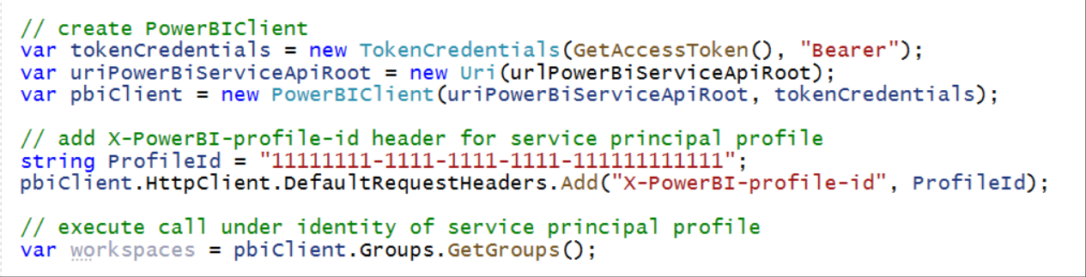
Setting Calling Context for Service Principal Profile
How do you set the X-PowerBI-profile-id header value?
Option #1 – you can set the header explicitly with GUID for service principal profile Id
ID for service principal profile

Slide 22
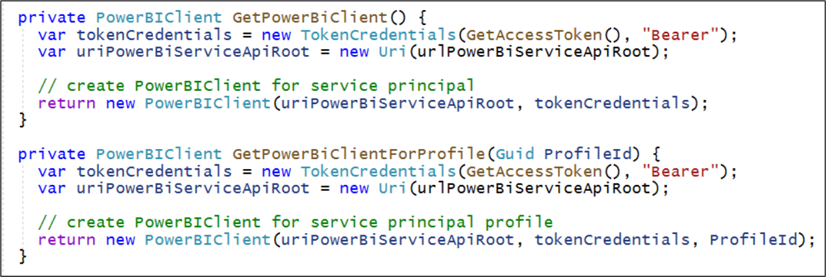
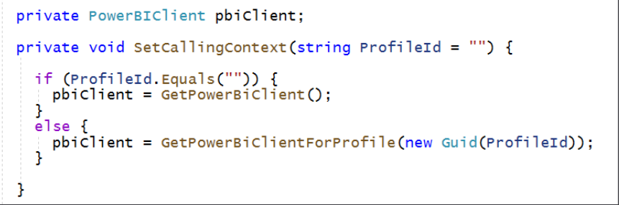
Initializing PowerBIClient Objects with ProfileId
Option #2 – Initialize PowerBIClient object with profile Id in constructor
Design code in App-Owns-Data embedding application to switch between contexts

Slide 23
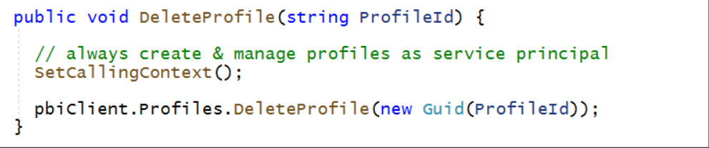
Creating and Deleting Profiles as a Service Principal
Call SetCallingContext with no parameters to execute code as service principal

Slide 24
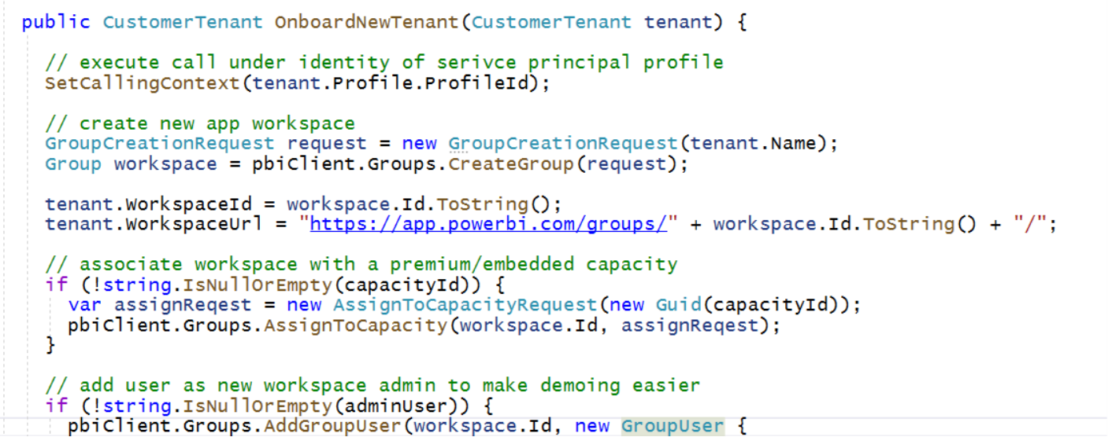
Creating and Configuring Workspaces as a Profile
Call SetCallingContext with profile name to run under profile's identity

Slide 25
Generating Embed Tokens as a Profile
Use the correct service principal profile when access content

Slide 26
Calling GenerateToken as Service Principal Profile

Slide 27
Agenda
Developing with Service Principal Profiles
Designing Multi-tenant Applications using Service Principal Profiles
Designing Datasets with Row Level Security (RLS)
Using RLS with App-Owns-Data Embedding

Slide 28
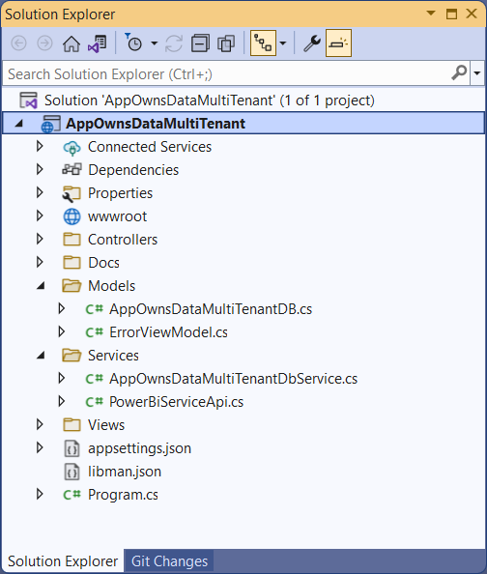
Developer Sample: AppOwnsDataMultiTenant
You can download and try out the sample code used in this webinar
Implemented as C#/.NET6 web application which uses the Power BI .NET SDK
Download from https://github.com/PowerBiDevCamp/AppOwnsDataMultiTenant

Slide 29
AppOwnsDataMultiTenant Design
Application requires one Azure AD application
Application uses a single service principal
Service principal creates and manages service principal profiles
Service principal profiles used to create and access customer tenant workspaces
Application creates new service principal profile for each customer tenant
Can scale Power BI multi-tenant environment upwards to 100,000+ workspaces
PBI API calls optimized as each service principal is member of only one workspace
Complete isolation of datasource credential across tenants

Slide 30
Application Architecture
Calls to Power BI REST API to create profiles and workspaces
Profiles are created and managed using service principal default identity
Workspaces are created and managed using service principal profile identities
Associations between profiles and workspaces tracked in custom database
AppOwnsDataMultiTenant
Power BI REST API

Slide 31
Create New Customer Tenants

Slide 32
A New Profile for Each New Customer Tenant
After creation, customer tenants can be seen on Tenants page
You can also see profile has been created from Profiles page

Slide 33
Inspecting Profiles with the Power BI Service API
Power BI Profiles page issues Power BI REST API call
Profiles returned from API should match profiles in AppOwnsDataMultiTenantDB

Slide 34
Agenda
Developing with Service Principal Profiles
Designing Multi-tenant Applications using Service Principal Profiles
Designing Datasets with Row Level Security (RLS)
Using RLS with App-Owns-Data Embedding

Slide 35
What Is Row-level Security (RLS)
Security Authentication Scheme based on Named Roles
Roles are defined using Power BI Desktop
Roles designed to limit data seen by a particular audience
Each role is scoped to the dataset within a PBIX project
Role defined using one or more DAX expressions
DAX expressions restrict which rows are accessible

Slide 36
RLS Roles
RLS roles are named filter sets
Each role defines 0 or more filters
When role contains multiple filters => filter restrictions AND-ed together
When user is in multiple roles => role restrictions Or-ed together
RLS Design Patterns
Static RLS designs involve creating multiple roles
Dynamic RLS designs typically based creating a single role for all users
Best practices
Design RLS so that users are added to single role
Avoid designs where user needs to be added to multiple roles

Slide 37
Create Roles in Power BI Desktop

Slide 38
Testing using View As Roles in Power BI Desktop

Slide 39
Creating an Admin Role to View All Data
Admin role contains no filters
Provides users that map to this role to see all data

Slide 40
Creating RLS Rules using Table Filter DAX Expressions
Rules best on equality (preferred)
Rule based on text search (beware performance issues!)

Slide 41
Configuring RLS in the Power BI Service
Configure role mappings
map members to dataset roles
Members can be user accounts or security groups
M365 Groups cannot be added to RLS role
Service principal cannot be added to RLS role - PBIE developers take note

Slide 42
GOTCHA - RLS Disabled for Users with Read/Write Access to Dataset
RLS enabled for users with read-only access to dataset
RLS disabled when user added in workspace role with edit permissions
When configuring access through workspace, user must be added a visitor
If possible, configure access through Power BI app where all users are read-only

Slide 43
Dynamic RLS
Design pattern for data-driven security
RLS set up to use login name of current user
Permission assignments are included as part of dataset
Implemented using bi-directional cross-filtering
data model extended with users table and permissions table

Slide 44
Dynamically Tracking the Current User
Filter user in RLS role using USERNAME() or USERPRINCIPALNAME()

Slide 45
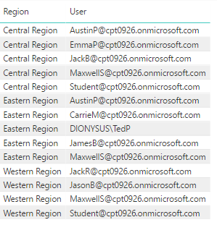
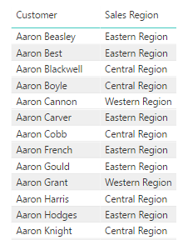
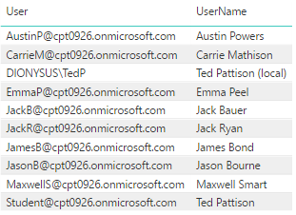
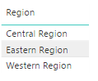
Dynamic RLS Table Filtering
Filtering starts with user and propagates inwards toward fact table
UserPermissions
Customers
Users
Regions

Slide 46
Test Dynamic RLS in Power BI Desktop

Slide 47
Map All Users to Single RLS Role using AAD Group

Slide 48
Dynamic RLS Enforcement

Slide 49
Agenda
Developing with Service Principal Profiles
Designing Multi-tenant Applications using Service Principal Profiles
Designing Datasets with Row Level Security (RLS)
Using RLS with App-Owns-Data Embedding

Slide 50
Demo Files For This Session
https://github.com/PowerBiDevCamp/RowLevelSecurity

Slide 51
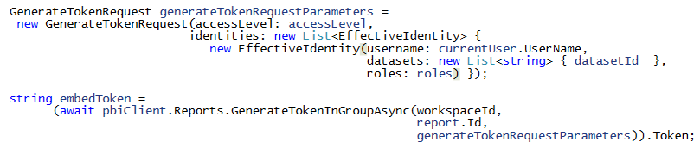
Use EffectiveIdentity to Embed RLS-enabled Reports
Programming with EffectiveIdentity required for RLS with App-Owns-Data
RLS-enabled reports require 1 or more roles for access
EffectiveIdentity must contain Dataset Id for dataset with RLS
Embed token can also carry username and custom data

Slide 52
Using the V2 Embed Token API – No Effective Identity Yet
Power BI REST API provides two options for generating embed tokens
Original Embed API generates embed token for a single resource
V2 Embed API allows you to generate embed token for multiple resources
You should prefer to use V2 Embed API in general application development

Slide 53
Creating Embed Tokens with Effective Identity

Slide 54
Limit Rules with Text Search to Minimal Number of Rows
Beware – don't use RLS rules with text search across large number of rows
Best practice - Refactor model to reduce number of rows
50 rows
375,000 rows
5,000,000 rows

Slide 55
Summary
Developing with Service Principal Profiles
Designing Multi-tenant Applications using Service Principal Profiles
Designing Datasets with Row Level Security (RLS)
Using RLS with App-Owns-Data Embedding

